Slide 1
GAME DEVELOPMENT USING C# AND .NETFRAMEWORKS
COMPUTER GRAPHICS AND MULTIMEDIA
SEMINAR
BY:-
MUKUL DEV (13BIT0269)
SIDDHARTHA UPADHYAY (13BIT0270)
KUMAR SUBHAM (13BIT0221)

Slide 2
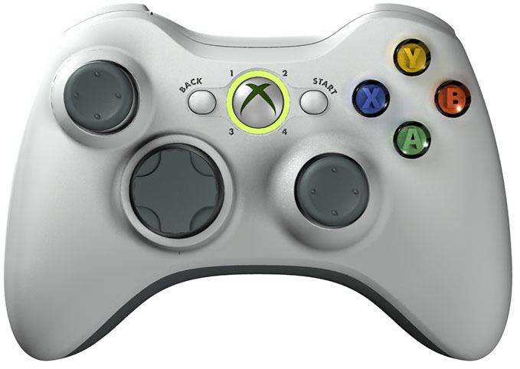
WHAT`S A GAME!??

Slide 3

How a game is made user interactive?
Game development is a software development process, as a video game is software with art, audio, and game play. Formal software development methods are often overlooked. Games with poor development methodology are likely to run over budget and time estimates, as well as contain a large number of bugs. Planning is important for individual and group projects alike.
One method employed for game development is agile development. It is based on iterative prototyping, a subset of software prototyping. Agile development depends on feedback and refinement of game's iterations with gradually increasing feature set. This method is effective because most projects do not start with a clear requirement outline. A popular method of agile software development is Scrum.
Another successful method is Personal Software Process (PSP) requiring additional training for staff to increase awareness of project's planning. This method is more expensive and requires commitment of team members. PSP can be extended to Team Software Process, where the whole team is self-directing.
Game development usually involves an overlap of these methods. For example, asset creation may be done via waterfall model, because requirements and specification are clear, but game play design might be done using iterative prototyping.

Slide 4
Continued…
Basically speaking about user interactivity it refers to how easy you can go in making a game for any user who is starting from scratch, because as a developer we have to consider the fact that not every person is a pro when it comes to gaming so the more the interactivity of the game the more will it become handy for any user and hence more number of people will be aware of it (for eg. The game of subway surfer or temple run are the ones in which a user is aught from the start how to go ahead and what is everything inside while on the other hand games like Hitman 1 did not became so popular because everytime people got stuck as to where and how to move ahead here were minimum no of instructions PS: they did make it more interactive later and I turned out to be one of the most sold games of that year )

Slide 5
How to make a game trending and popular
Make something that is considered impossible. If you would make an app that would let people see through walls, you would get rich in one day. Everybody would be talking about this.
Make something people will find funny. Is there anything more funny in this world than little bird shot from the slingshot?
Make something that will intrigue, surprise, shock, disgust and so on. If you want people to talk abut your app to their friends, you have to do something they will remember.
Make something very useful or fun to play if it’s a game. If you do that, people will use your app or play your game many times. The longer they play, the higher the chance that they will tell their friends about it.
Give people the opportunity to talk about your app or game. If you have a score system in your game, make a special, easy to use button that will let people share their scores on Facebook and Twitter.

Slide 6
c# and .net framework in game (Microsoft XNA and its framework)
Microsoft XNA (a recursive acronym for XNA's Not Acronymed) is a freeware set of tools with a managed runtime environment provided by Microsoft that facilitates video game development and management. XNA is based on the .NET Framework, with versions that run on Windows NT, Windows Phone and the Xbox 360. XNA content is built with the XNA Game Studio, and played using the XNA Framework (for Windows games), or published as native executables (for Xbox 360, Windows Phone and Zune).
In many respects, XNA can be thought of as a .NET analog to Microsoft's better known game development system, DirectX, but it is aimed at developers primarily interested in writing lightweight games that run on a variety of Microsoft platforms. XNA is the basic platform for Xbox Live Indie Games.
The XNA toolset was announced March 24, 2004, at the Game Developers Conference in San Jose, California. A first Community Technology Preview of XNA Build was released on March 14, 2006. XNA Game Studio 2.0 was released in December 2007, followed by XNA Game Studio 3.0 on October 30, 2008. XNA Game Studio 4.0 was released on September 16, 2010 along with the Windows Phone Development Tools. According to an email sent on 31 January 2013, XNA is no longer actively being developed, and it is not supported under the new "Metro interface" layers of Windows 8 nor on the Windows RT platform.

Slide 7
History of c# and .net frame works
C# is an object oriented programming language built on top of the .NET framework. C# Is a higher level language that enables you to write code fast. Compared to C++, there are some differences one should be aware of.
The .NET framework is built by Microsoft. It offers seamless collaboration between libraries written in different programming languages. .NET is a managed framework, meaning certain things are handled for you, such as garbage collection. .NET programs aren’t, unlike C++, compiled to machine code, but rather to an intermediate language, called CIL (Common Intermediate Language). This CIL code is then translated to machine code at run time by the CLR (Common Language Runtime), by making usage of JIT (Just In Time) compilation.
There are several programming languages you can use to develop on the .NET framework, such as C#, VB.NET, C++/CLI, Boo, … All these languages are compiled to the same CIL. Because all programs are compiled to an intermediate language, it’s also fairly easy to decompile it again (to the same, or another programming language). If you want to decompile .NET code, take a look at Reflector.NET.

Slide 8
Continued….
Development using the .NET framework has its advantages and disadvantages when comparing to development in C++. Let us start with the advantages. First of all, you can develop a lot faster when compared to C++. One might say that you produce code at about 5 times the speed than you would in C++. Second of all, it’s a lot easier an more accessible than C++. And you have a garbage collection system which offers automatic deallocation, eliminating almost all memory leaks. It’s also cross platform, meaning your code will work on several versions of Windows, and if you use the compact framework, your code will work on mobile devices, Xbox 360 and Windows Phone. With the help Mono, your code will even run on Linux (Note: not all .NET features are supported on Mono). The Unity3D gamdev IDE is built on top of Mono.
Development using the .NET code also has some disadvantages. First of all, because your code is compiled to an intermediate language, it’s a lot easier to decompile code than it would be with C++ code. Luckily several obfuscating techniques exist that make this process more difficult. The garbage collector (“GC”) can also be a disadvantage. One has to have a good understanding about what it does to make sure it doesn’t become a bottleneck. The GC on the Windows is fairly advanced, but the one on the compact framework isn’t as effective. When building games in XNA for Xbox 360 and Phone 7 Series, the GC will be something you will have to pay attention to. Then the final thing is that .NET code can run slower than C++. But let us be honest, isn’t this the same discussion that we have when moving from Assembler to C? Or from C to C++? Also, bear into mind that it’s fairly easy to write slow C++ code if you don’t know what you’re doing; doing so in .NET is a bit harder since the framework manages a lot for you.

Slide 9
Implementing c# and .net in gaming (eg. Of a pencilsharpener )
First we have to develop a UI because without that game has no meaning .
What's an Interface?
An interface is a reference type object with no implementation. You can think of it as an abstract class with all the implementation stripped out and everything that is not public removed. Abstract classes are classes that can not be instantiated. No properties or methods are actually coded in an interface, they are only defined. So the interface doesn't actually doanything but only has a signature for interaction with other classes or interfaces. A good analogy for an interface is a pencil and a pencil sharpener. When we talk of a pencil and a pencil sharpener we generally know what they do and how they interact. We don't have to know the inner workings of a particular sharpener or pencil, only how to use them through their interface.
public interface IPencil
{
void Write();
bool IsSharp { get; }
}
public interface IPencilSharpener
{
void Sharpen(IPencil pencil);
}

Slide 10
Implementing continued…
Why Use Interfaces?
This make for a much easier "code world" in which to navigate. Imagine if instead of learning how to drive a car and then being able to drive any car, we had to learn how to drive each instance of every car we get into. It would be really inefficient if after learning how to drive the Ford Pinto we had to start all over again in order to figure out the Mustang. A much more efficient way is to deal with the cars interface: the steering wheel, turn signals, gas pedal and brake. This way, no matter what is implemented on the backend of the interface, we don't really care because in the end it subscribes to the basic car contract and that is how we will deal with it (through the interface).

Slide 11
Implementing continued…
Why Use Interfaces?
This make for a much easier "code world" in which to navigate. Imagine if instead of learning how to drive a car and then being able to drive any car, we had to learn how to drive each instance of every car we get into. It would be really inefficient if after learning how to drive the Ford Pinto we had to start all over again in order to figure out the Mustang. A much more efficient way is to deal with the cars interface: the steering wheel, turn signals, gas pedal and brake. This way, no matter what is implemented on the backend of the interface, we don't really care because in the end it subscribes to the basic car contract and that is how we will deal with it (through the interface).

Slide 12
XNA MICROSOFT DETAILED IMPLEMENTATION AND USE
Since xna uses C# as one of the primary languages in game developing therefore covering it in this presentation is critically important
You write your game in C#
Using features in XNA Framework
Runs on top of common language runtime (“Managed Code”)
Game code (C#) & content
XNA Framework
Common Language Runtime (CLR)
Windows APIs, DirectX

Slide 13
Xna continued….
XNA Features
2D & 3D graphics support
Access to HLSL (High level shader language)
Pixel and vertex shaders
Audio support
XACT cross-platform audio tool
Controller and keyboard input
Xbox 360 controller
Font support
Content Pipeline
Game save storage
Networking
… and much more

Slide 14
Xna continued….
Step 1: Install Your Software
Before you begin, make sure that you have installed all the necessary software, including a supported version of Microsoft Visual Studio tools and XNA Game Studio.
Step 2: Create a New Project
From the Start menu, click All Programs, click the XNA Game Studio 4.0 folder, and then click your supported version of Microsoft Visual Studio tools.
When the Start Page appears, click the File menu, and then click New Project.
A dialog box appears with a tree list on the left pane, marked Project Types.
Select the XNA Game Studio XNA Game Studio 4.0 tree node underneath the Visual C# node.
A set of available projects appears in the right pane.
In the right pane of the dialog box that appears, click Windows Game (4.0), and then type a title for your project (such as "MyFirstGame") in the Name box.
Type a path where you'd like to save your project in the Location box, and then click OK.
After creating a new project, you'll be presented with the code view of your game.

Slide 15
Xna continued…
Step 3: View the Code
Some of the hard work has already been done for you. If you build and run your game now, the GraphicsDeviceManagerwill set up your screen size and render a blank screen. Your game will run and update all by itself. It's up to you to insert your own code to make the game more interesting.
Much of the code to start and run your game has already been written for you. You can insert your own code now.
The Initialize method is where you can initialize any assets that do not require a GraphicsDevice to be initialized.
The LoadContent method is where you load any necessary game assets such as models and textures.
The UnloadContent method is where any game assets can be released. Generally, no extra code is required here, as assets will be released automatically when they are no longer needed.
The Update loop is the best place to update your game logic: move objects around, take player input, decide the outcome of collisions between objects, and so on.
The Draw loop is the best place to render all of your objects and backgrounds on the screen.

Slide 16
Xna continued…
Step 4: Add a Sprite
The next step is to add a graphic that can be drawn on the screen. Use a small graphics file, such as a small .bmp or .jpg file. Be creative—you can even make your own. You can even skip ahead a bit and make a sprite that "hides" parts that should not be seen (such as edges or corners) so that it looks even better.
Once you have a graphic picked out on your computer, follow these steps.
Make sure you can see the Solution Explorer for your project on the right side of the window. If you cannot see it, click the View menu, and then click Solution Explorer.
When it appears, you will see files associated with your project in a tree structure. Inside the tree, you will see a node named Content.
Right-click the Content node, click Add, click Existing Item, and then browse to your graphic.
If you can't see any files, make sure you change the Files of type selection box to read Texture Files.
Click the graphic file, and then click Add.
An entry for the graphic file will appear in Solution Explorer.
Click the entry for the graphic in the Solution Explorer. If you do not see the entry, ensure the Content node is expanded by clicking the small plus sign (+) to the left of the node, and then click on the entry that appears underneath the Content node.
When you add a graphic file, it is added automatically to the XNA Framework Content Pipeline. This allows you to quickly and easily load the graphic into your game.
In the Properties window below Solution Explorer, look for the "Asset Name" property. Note the name; you'll use it in your code to load the graphic so it can be displayed in your game.
If the Properties window is not visible, press F4, or click the View menu, and then click Properties Window.
Now, you must write code that loads and displays the sprite on the screen.
Back in the Code view of your game, find the LoadContent method, and add the following lines in and above the method so it looks similar to this:

Slide 17
Xna continued…
// This is a texture we can render.
Texture2D myTexture; // Set the coordinates to draw the sprite at.
Vector2 spritePosition = Vector2.Zero; // Store some information about the sprite's motion.
Vector2 spriteSpeed = new Vector2(50.0f, 50.0f);
protected override void LoadContent()
{ // Create a new SpriteBatch, which can be used to draw textures.
spriteBatch = new SpriteBatch(GraphicsDevice);
myTexture = Content.Load<Texture2D>("mytexture");
}

Slide 18
Xna continued… just in case if ur wondering what is sprite!!?
Sprites are positioned on the screen by coordinates. The width and height of the screen is the same as the back buffer. The x-axis represents the screen width and the y-axis represents the screen height. The y-axis is measured from the top of the screen and increases as you move down the screen, and the x-axis is measured from left to right. For example, when the graphics back buffer is 800×600, 0,0 is the upper left of the screen, and 800,600 is the lower right of the screen.
To draw a sprite, create a SpriteBatch object, initialize it by calling Begin, and then call Draw for each sprite. The bitmap data for a sprite is taken from a Texture2D object. The texture may contain alpha channel information to make part of the texture transparent or semi-transparent. You can tint, rotate, or scale sprites by using Draw. This method also gives you the option of drawing only part of the texture on the screen. After you draw a sprite, call End before calling Present.

Slide 19
TITLE GAME1 : OBSTACLOFY
In this game you control the mivement of the oval shaped body and you have to avoid being hit by the obstacles by jumping.
once you get hit the game gets over. have fun :)

Slide 20
TITLE GAME 2 : COnTROL SHOOT
in this game a particle is freely falling under gravity which has to be shooted by one of the three guns. once the partile crosses the bottom boundary without being hit, the game is over.
each gun has six bullets loaded in it, you can use only one gun at a time. if you successfully hit the target you get the score.
try to get the maximum score and have fun :)

Slide 21
Coding behind our game
(brace yourselves it will get technical from here )
using System;
using System.Collections.Generic;
using System.ComponentModel;
using System.Data;
using System.Drawing;
using System.Linq;
using System.Text;
using System.Threading.Tasks;
using System.Windows.Forms;

Slide 22
Continued…
namespace main
{
public partial class Form1 : Form
{
static int d = 0;
static int c = 0;
int[] a = new int[6]{ 0,0,0,0,0,0 };
int[] a2 = new int[6];
int top;
int top2;
enum position
{
left, right, up, down
}
int _x1;
int _y1;
int _x2;
int _y2;
int _x3;
int _y3;
int _x4;

Slide 23
int _y4;
int _x5;int _y5;
private position _objposition;
public Form1()
{ _x1 = 0;
_y1 = 50;
_x2 = 0;
_y2 = 250;
_x3 = 0;
_y3 = 450;
_x4 = 530;
_y4 = 0;
_x5 = 120;
_y5 = 90;
top = 5;
top2 =-1;
InitializeComponent();
}
private void Form1_KeyDown(object sender, KeyEventArgs e)
{
if (e.KeyCode == Keys.Right)
{
if (c == 0)
{

Slide 24
c++;
pop();
// label1.Text = f.ToString(); }
_objposition = position.right;
}
if (e.KeyCode == Keys.Down)
{
_objposition = position.down;
}
}
private void Form1_Paint(object sender, PaintEventArgs e)
{
e.Graphics.FillRectangle(Brushes.Red, _x1, _y1, 120, 100);
e.Graphics.FillRectangle(Brushes.BlueViolet, _x2, _y2, 120, 100);
e.Graphics.FillRectangle(Brushes.BlueViolet, _x3, _y3, 120, 100);
e.Graphics.FillRectangle(Brushes.BlueViolet, _x4, _y4, 70, 50);
e.Graphics.FillRectangle(Brushes.BlueViolet, _x5, _y5, 20, 10);
}
private void timer1_Tick(object sender, EventArgs e)
{
_y4 += 7;
Invalidate();
}

Slide 25
Continued…
private void timer2_Tick(object sender, EventArgs e)
{
if (_objposition == position.down)
{
_y5 += 10;
_x5 += 10;
}
if (_objposition == position.right)
{
_x5 += 15;
}
if (_x5 >= 530)
{
timer1.Stop();
timer2.Stop();
show();
}
Invalidate();
}
private void show()
{ int a = _y5;
int b = _x5;
int c = _x4;
int d = _y4;
if (a > (d - 10) && a < (d + 60))

Slide 26
{
push(0);
Form2 f2 = new Form2(top, top2); this.Hide();
f2.ShowDialog();
}
else
MessageBox.Show("GAME OVER");
}
public void push(int item)
{
if (top == 6)
MessageBox.Show("No more bullets can be loaded");
else
{
top2 = top2 + 1;
a2[top2] = item;
label4.Text = (top2 + 1).ToString();
}
}

Slide 27
Continued…
public void pop()
{
if (top == -1)
MessageBox.Show("No bullets left");
else
{
top--;
label1.Text = (top+1).ToString();
}
}private void timer3_Tick(object sender, EventArgs e)
{
}
private void Form1_Load(object sender, EventArgs e)
{
}
}
} //end

Slide 28
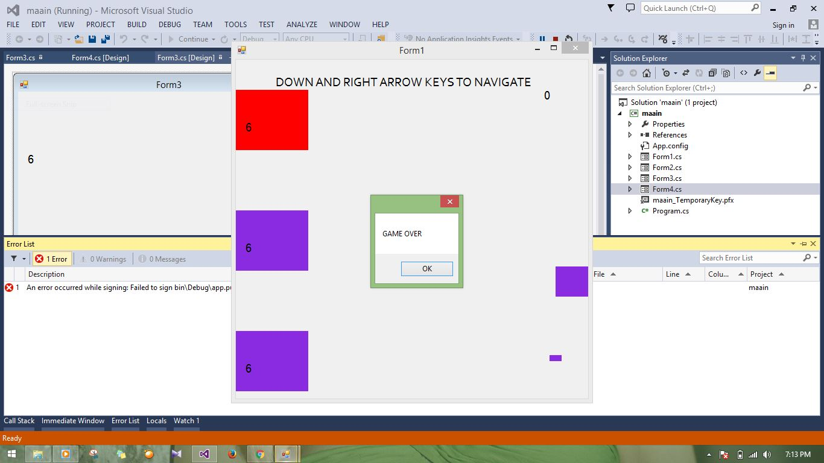
Screenshot of game developed

Slide 29
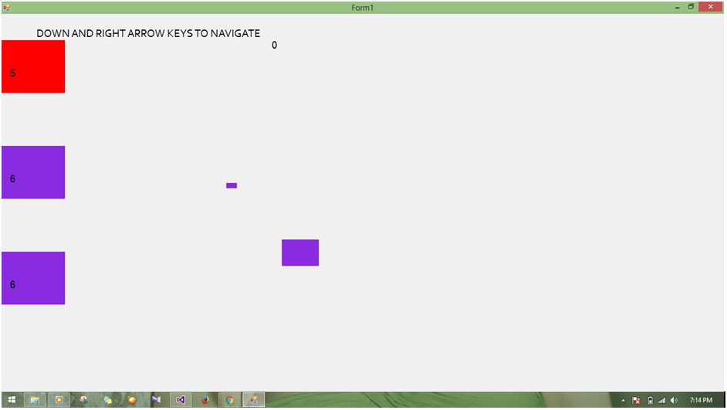
Screenshot of game developed

Slide 30
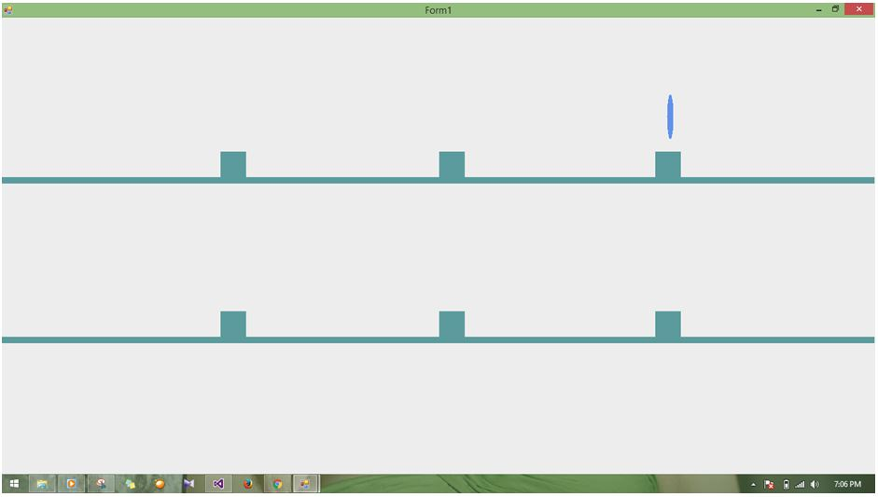
Screenshot of game developed

